Slide 1

Health Equity
Versilla Turner, MS, RDN
Florida Department of Health in Escambia County
April 21, 2017

Slide 2
Health Equity
Relationship of SDOH and health behaviors
Examples of health disparities
The difference in equality and equity
The impact of poverty and chronic stress
Changing the way we think of health

Slide 3
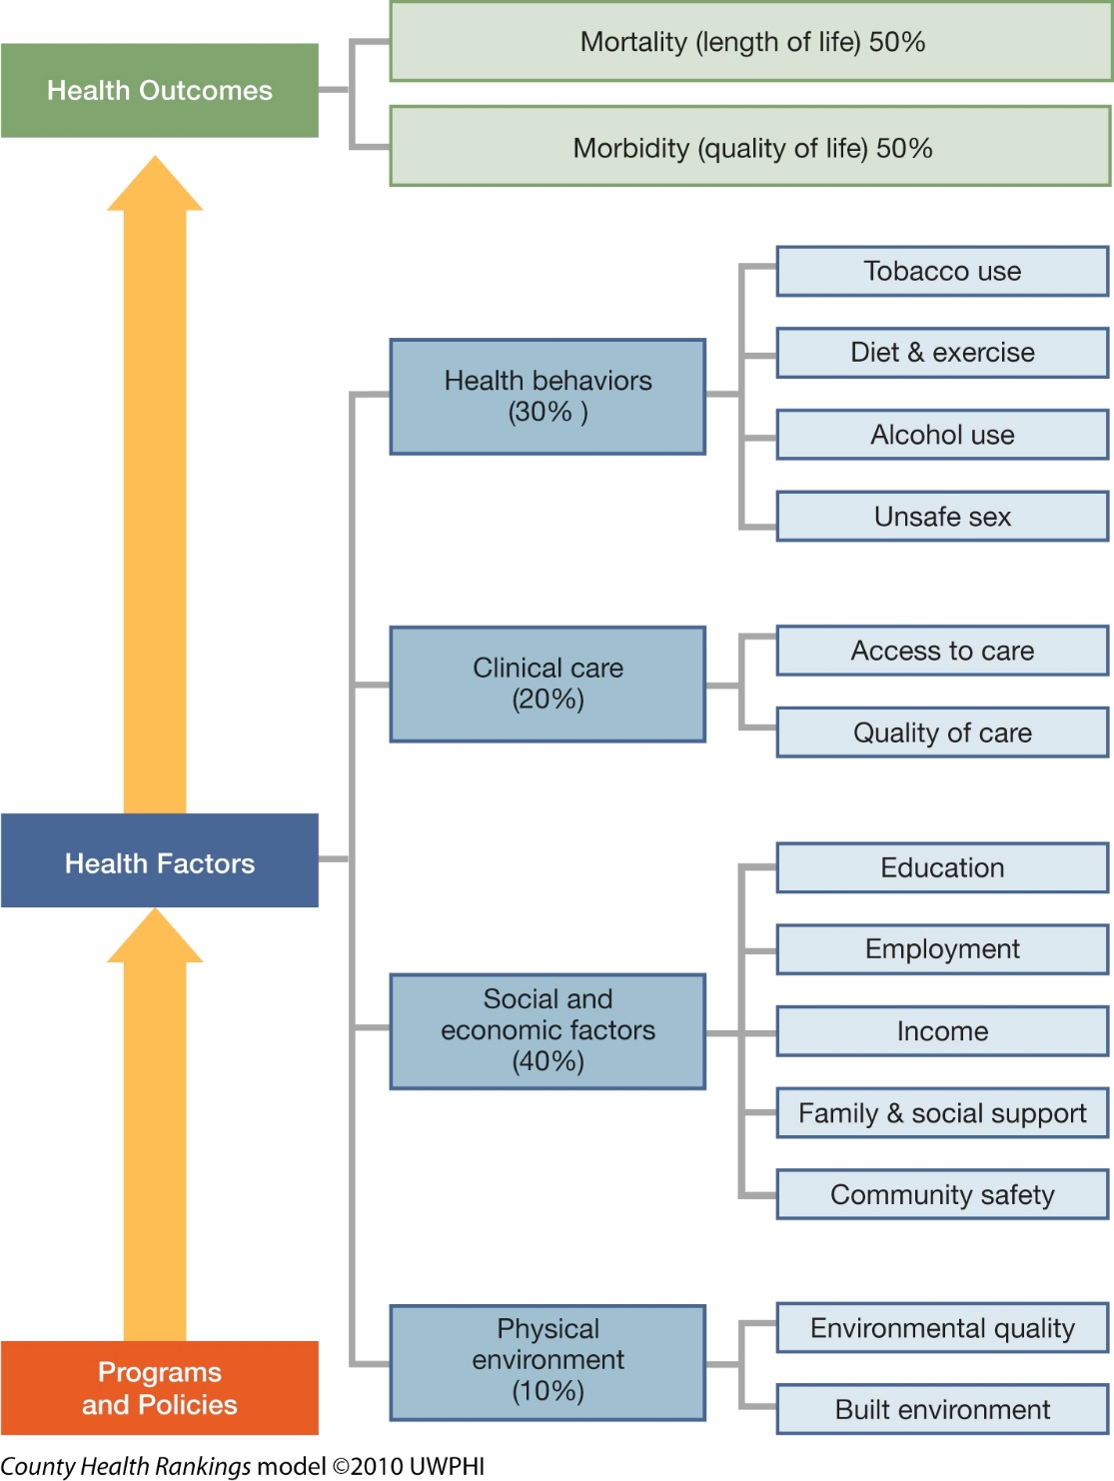
Notes:
Developed in 2003 to rank Wisconsin counties. Used nationally since 2010. Released in March every year. Looks only at modifiable factors – age, sex, genetics are not factored in – which makes sense if you are trying to impact community health.
Environment includes air and water quality, aw well as the build environment – parks, grocery stores, community gathering places, bikeabiltiy and walkability

Slide 4
RWJF County Health Ranking 2017
1 St. Johns (SJ)
2 Collier (CO)
3 Sarasota (SS)
4 Martin (MA)
5 Seminole (SO)
6 Clay (CL)
7 Monroe (MO)
8 Santa Rosa (SR)
9 Palm Beach (PB)
10 Nassau (NA)
11 Broward (BW)
12 Okaloosa (OL)
13 Flagler (FL)
14 Lake (LA)
15 Charlotte (CH)
16 Lee (LE)
17 Sumter (ST)
18 Indian River (IR)
19 Miami-Dade (DA)
20 Brevard (BV)
21 Orange (OR)
22 Wakulla (WK)
23 Leon (LO)
24 Manatee (MN)
25 Alachua (AL)
26 Pinellas (PL)
27 Lafayette (LY)
28 Hillsborough (HB)
29 St. Lucie (SL)
30 Gilchrist (GI)
31 Gulf (GU)
32 Osceola (OS)
33 Calhoun (CA)
34 Walton (WT)
35 DeSoto (DE)
36 Polk (PO)
37 Pasco (PA)
38 Bay (BY)
39 Franklin (FR)
40 Volusia (VO)
41 Highlands (HL)
42 Washington (WG)
43 Hernando (HN)
44 Citrus (CI)
45 Jackson (JS)
46 Hardee (HA)
47 Glades (GL)
48 Duval (DU)
49 Marion (MR)
50 Baker (BA)
51 Liberty (LI)
52 Taylor (TA)
53 Hendry (HE)
54 Columbia (CU)
55 Escambia (ES)
56 Suwannee (SN)
57 Levy (LV)
58 Holmes (HM)
59 Dixie (DI)
60 Jefferson (JE)
61 Bradford (BF)
62 Okeechobee (OK)
63 Hamilton (HT)
64 Madison (MS)
65 Putnam (PN)
66 Union (UN)
67 Gadsden (GA)
Notes:
This is how Escambia ranked in the most recent County Health Rankings
55 Overall
Robert Woods Johnson Foundation. “Health Outcomes in Florida.” County Health Rankings & Roadmaps (Revised 2016). Web 13 Mar. 2017.

Slide 5
What Determines Health?
Age
Sex
Diet and exercise
Smoking and Safe Sex
Healthy Life
Health Factors that we cannot control
Health Factors that can change
Health Outcomes
Genetics
Education and
Environment
Employment and Income
Long Life
Notes:
This looks like a pretty straightforward, linear equation, right? Unfortunately, life nor science, is ever that simple

Slide 6
It’s all connected..
Health
Income
Environ-ment
Behavior
Access to Health Care
Family & Community Support
Education
Employ-ment
Notes:
We often think of health behaviors as simple personal decisions. If she didn’t eat so much, she wouldn’t have diabetes, if he didn’t smoke, he wouldn’t have emphysema. If she had gone for regular check-ups, the doctors would have caught that earlier…
We know that poverty influences your environment, where you live. Your neighborhood environment can influence your behaviors – is it safe, are there green spaces, do you have access to healthy food? Neighborhood environment affects housing quality, air quality and access to quality medical care. Family and community support impacts education, education impacts employment, employment impacts income and your work environment. Income influences education, education impacts behaviors. And we can just keep going in the circle and cross contamination of factors that influence health.
This doesn’t really help us define what really impacts health, does it? It really confounds the issue at every point. It always seems to come back to one root cause - POVERTY

Slide 7
The Advantage Walk
Notes:
I want us to do an exercise that will help us think of influencing factors at a more personal level. It’s called the Advantage Walk or Privilege Walk. Technically we should all stand in a line and take steps forward or back to actually demonstrate how advantages are picked up, primarily during childhood and adolescence. For our purpose today we are going to do this standing in place. I’d like everyone to stand up and follow instructions as I ask these questions. You can step in place, or if its more comfortable for you, do it mentally. The important thing is to think about how these factors influenced your life.
Think about how many steps forward you took. How do you think these “advantages” influenced your behavior, your aspirations and self-confidence? How might your life have been different if you didn’t have those steps?
Or– think about yourself, a family member or client that took numerous steps back. Imagine again how that life course might have been different without those steps.
Adopted from the Privilege Walk, State University of New York at Albany

Slide 8
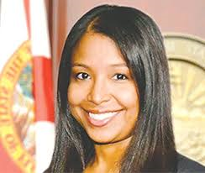
Health Equity
Impacts on Public Health Practices
Notes:
In this first year of focus on health equity, the department goal is to educate all directors. The next is to educate staff – something we are doing now. Eventually our efforts will expand to inform community partners.
If you listen to Dr. Phillips speak you will notice she talks frequently about looking at health through the equity lens. What does that mean? The idea is to identify vulnerable populations in our community, groups experiencing health disparities -- and in every program, every activity you plan, think about how to get the public health message to this group and how to get the needed services to them.
When Dr. Phillips speaks about health disparities and achieving equity, she is referring to disparities rooted in the social context that can be modified.

Slide 9

Modifiable Health Disparities
Looking at Population Health through an Equity Lens
Notes:
Let’s look at some common disparities

Slide 10

Education
Notes:
Education is associated with longer life expectancy, improved overall health and quality of life; and health-promoting behaviors - like getting regular physical activity, not smoking, and going for routine checkups and recommended screenings.
This example shows smoking rates by education. Using the health equity lens, where would we focus our efforts?
Florida Health Charts (2012-2014). Web 13 Mar. 2017.

Slide 11
Income
Notes:
If we look at our community and see this pattern, where would we focus our diabetes interventions in the health equity model?
Florida Behavioral Risk Factor Surveillance System. “Adults Who Have Ever Been Told They Had Diabetes by Income.” Florida Health Charts (2013). Web 13 Mar. 2017.

Slide 12
Race
}
Black Rate almost 3 times higher than White Rate
Notes:
Infant mortality is almost 3X higher for blacks than whites in Escambia. This disparity pattern holds true throughout the US. It holds true regardless of education or income. I know what you’re thinking. It must be biological. It’s race. Race is not modifiable so why are we talking about it when discussing community health?
Because race is not the root cause.
Florida Health Charts (2012-2014). Web 13 Mar. 2017.

Slide 13
Race
Black Rate 1.6 times higher than White Rate
}
Black Rate almost double White Rate
}
2012-2014
Notes:
Researchers looked at women in Africa and recent African immigrants to the U.S. and found they had similar birth outcomes to white women in the U.S., but African American women (those living in this country) tended to have babies that weighed significantly less, with higher rates of prematurity and infant mortality. Even more striking - outcomes for the African-born women worsened within one generation of living in the United States and became comparable to African American women who had been here all of their lives.
So what’s going on here? It seems clear from this research that something in the U.S. is negatively impacting birth outcomes. The theory is that chronic stress related to racism and systematic discrimination may be the factor. It’s sometimes called ‘weathering.” There is ongoing research in this field
Florida Health Charts (2012-2014). Web 13 Mar. 2017.

Slide 14
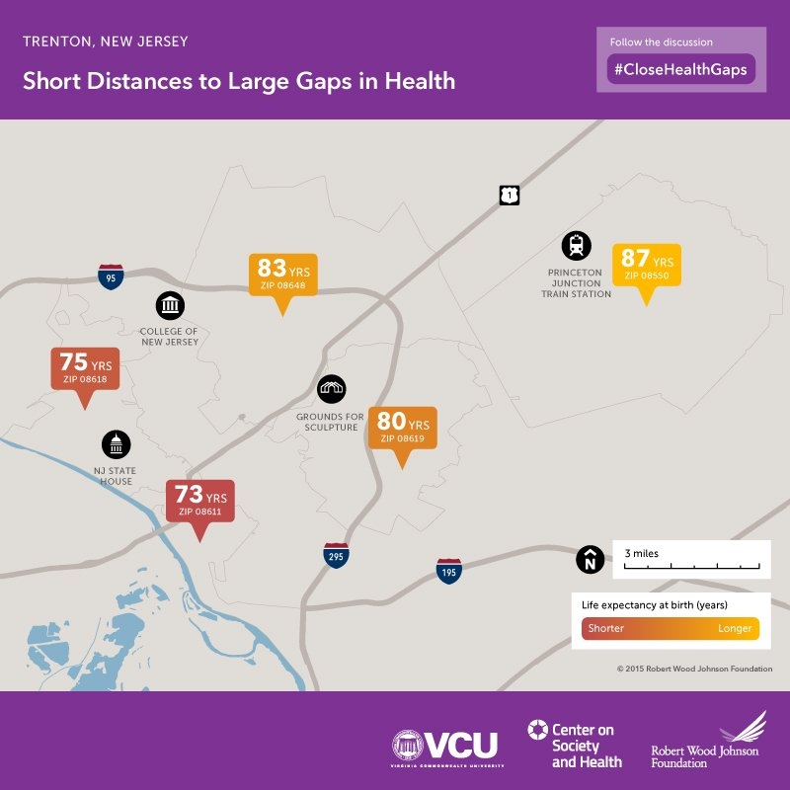
ZIP Code
Princeton and Trenton New Jersey
Notes:
Where you live may be more important to your health than your DNA.
Study supported by the RWJF and Virginia Common wealth university. Very similar to the story in the movie, “Unnatural Causes.” Fourteen year life expectancy difference within 13 miles
Princeton is home to numerous financial institutions, Merck, Honeywell, Bristol-Myers, Dow, Hyatt Regency, Merrill Lynch, Johnson and Johnson
Average income in Princeton Household $116,271 Individual $63,271
Trenton experienced economic recession, loss of manufacturing jobs, unemployment, more temporary or part-time employment, and employment without insurance,
Average income in Trenton Household $34,257 Individual $16,914 (2011-2015)

Slide 15
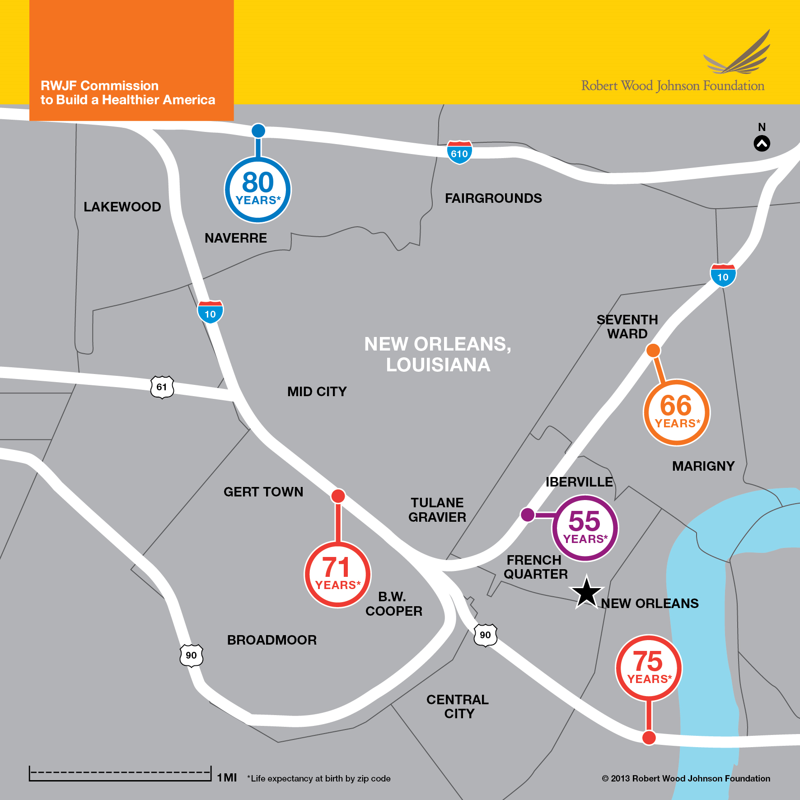

Slide 16
Health by zip code?
Notes:
Household Income
Pensacola 46K Gulf Breeze 58K Palm Beach 60K Boulder 66K Newton 100K Princeton 116K
Boulder, Colorado is often identified as the healthiest city in the US in terms of obesity and physical activity, but their income falls below places like Newton and Princeton, NJ, and so does their life expectancy.
Money can’t buy happiness – apparently it can buy health. Actually, it’s the flip side that’s true. Poverty creates poor health.
www.city-data.com/city April 7, 2017

Slide 17
Why are some neighborhoods so much healthier than others?
Unsafe or unhealthy housing
Fewer opportunities to be active – parks, green spaces, walkability
Proximity to highways, factories, pollutants
Limited access to primary care doctors
Unreliable or expensive public transit, limited job opportunities
Residential segregation (highways,
waterways, etc.)
Notes:
Unsafe or unhealthy housing exposes residents to allergens and other hazards like overcrowding. Stores and restaurants selling unhealthy food may outnumber markets with fresh produce or restaurants with nutritious food.
Opportunities for residents to exercise, walk, or cycle may be limited, and some neighborhoods are unsafe for children to play outside.
Proximity to highways, factories, or other sources of toxic agents may expose residents to pollutants.
Access to primary care doctors and good hospitals may be limited.
Unreliable or expensive public transit can isolate residents from good jobs, health and child care, and social services, and create long transit times
Residential segregation and features that isolate communities (e.g., highways) can limit social cohesion, stifle economic growth, and perpetuate cycles of poverty.

Slide 18

Why are some neighborhoods so much healthier than others?
Poor school funding
Access to low quality foods
Prevalence of tobacco sales
Availability of alcohol,
numerous liquor stores
Exposure to violence
Notes:
There are additional impacts on children and adolescents in poor neighborhoods.
Communities with weak tax bases cannot support high-quality schools and jobs are often scarce in neighborhoods with struggling economies.
This exacerbates the cycle of poor education, low-paying jobs, reduced family income

Slide 19
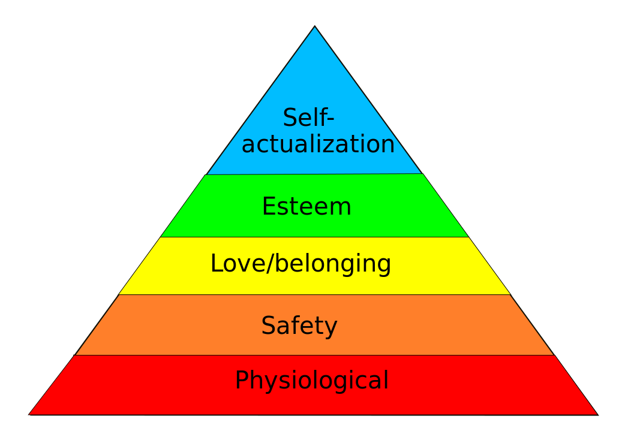
Poverty, Stress, and Disease
Maslow’s Hierarchy
Food, Water and Shelter
Scarcity forces people to think differently
Notes:
Clearly where you live, POVERTY, impacts your health and health behaviors. We’ve known for a long time that poverty by itself changes the way we think.
Many of you may remember Maslow’s Hierarchy – states that basic needs like food and shelter and safety must be achieved before people move to the social context of love and belonging and self-esteem
Scarcity forces people to think differently. Poverty increases focus on immediate needs and reduces long-term planning Many health behaviors require long term thinking

Slide 20
Stress and Disease
Physiological changes with chronic stress
  Stress hormones mobilize glucose
  Raises blood pressure
  Increases heart rate
  Lowers immune response
  Chronic inflammation (increased CVD risk)
  Elevates bad cholesterol
  Can change your DNA
    Changes that don’t alter sequence, but influence gene expression or suppression (Epigenetics)
Notes:
The chronic stress of poverty is toxic.
Poverty gets under our skin and leads to biological changes that can last into adulthood, even when circumstances changes. There are countless studies on the biologic mechanisms of the stress of always being on the edge of a cliff and barely holding on.
Epigenetics is the study of changes in a chromosome that affect gene activity or expression. You may be predisposed to diseases – may or may not be turned on. Triggers include viral, environmental or other factors. Chronic stress is one of those factors

Slide 21
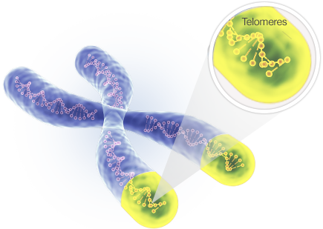
Stress and Disease
Notes:
Chronic severe stress can change us at a cellular level. This represents a DNA strand. Telomeres are a protective casing at the end of a strand of DNA – think of them as the hard casings at the end of a shoelace. Each time a cell divides, it loses a bit of this protective coating. The ability to replenish this diminished with age. Studies in labs as well as on human subjects show that chronic stress and cortisol exposure decreases our ability to replenish this protective casing – it ages the cell. This has been demonstrated in lab rats and among human subjects (PNAS study on women in domestic violence situations or raising disabled children compared to low stress controls). Chronic severe stress may literally age you at the cellular level

Slide 22
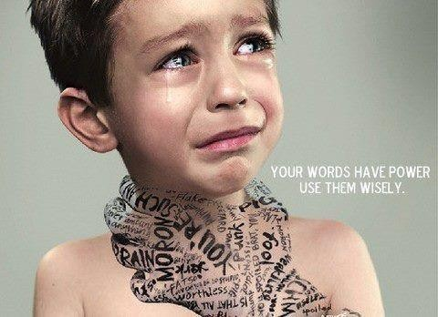

Stress and Disease
“Adverse childhood events are a significant unaddressed public health threat.”
Dr. Robert Block, former President of the AAP
Notes:
Severe stress in childhood can have profound and lasting effects.
Adverse Childhood Events - Original study by the Kaiser foundation 1990 with 17000 adults, 75% scored at least one, 1 in 8 scored 4 or more. These were insured, middle income people, most with some college education. Adverse Childhood Events questionnaire included physical, mental, emotional abuse, physical and emotional neglect, substance abuse and mental illness, domestic violence, incarceration of a household member and divorce.

Slide 23
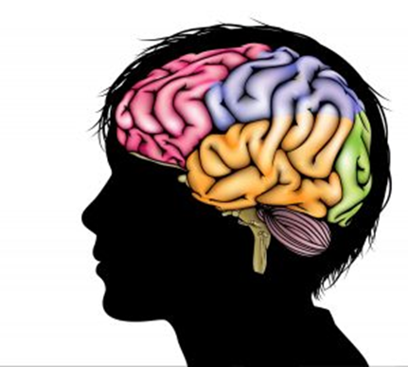
Stress and Disease
Four or more
Adverse Childhood Events
  Increases the risk for 7 of the
  10 leading chronic diseases. CDC
  Triples the risk of CVD
  Reduces life expectancy by 20 years
  Risks persisted even in the absence of risky behaviors as an adult.
Affects the developing brain, immune
system, hormones, gene expression
Notes:
Disease risks = obstructive pulmonary ds by 2.5 X that of someone with zero. 2.5 X the risk of hepatitis, 4X the risk of depression, 7X the risk of lifetime lung cancer and 3X the risk of heart disease.
Impacts the old debate – Nature or Nature? Social and genetic causes of disease are not mutually exclusive. Bad or good genes may be expressed by triggers in the social or physical environment
What are the protective factors? Meeting basic needs such as food and shelter, building family and social support, supporting education and opportunities for youth to build self-esteem,
Dr. Tom Boyce, Chief of UCSF’s Division of Developmental Medicine
Boyce points to a recent study in Nature Neuroscience showing that the further you go up the scale in parental education, the more folding – or cortical surface area – is evident in a child’s brain. Cortical surface area sets humans apart from other species; our brains fold inward to squeeze more surface area into our skulls. The kids with the better-educated moms had literally more brain in regions supporting language, reading, executive functions and spatial skills. “These differences are the central nervous system underpinnings of growing up in poverty
Public Health Reports, 2014 Jan-Geb, 129 (Suppl2) 19-31Paula Braveman, MD, MPH and Laura Gttlieb, MD, MPH

Slide 24
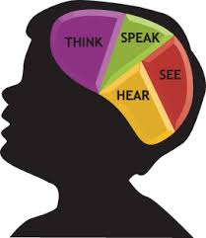
Stress and Disease
“It’s especially important to
understand that neurobiological
differences we find among children
from disadvantaged communities
(attention span, cognitive flexibility, short term memory) does not imply the differences are genetic in origin. Rather, many of the disparities in brain structure and function are the direct consequences of early rearing in impoverished, chaotic and stressful conditions”
  Dr. Tom Boyce, Chief of UCSF’s Division of Developmental Medicine
Notes:
This is profound and really makes it imperative that we focus on emotional, mental, and physical health of children. If we don’t the consequences can last a lifetime
When acute and chronic stress occurs during childhood, the impact is significant and can last a lifetime.
Boyce points to a recent study in Nature Neuroscience showing that the further you go up the scale in parental education, the more folding – or cortical surface area – is evident in a child’s brain. Cortical surface area sets humans apart from other species; our brains fold inward to squeeze more surface area into our skulls. The kids with the better-educated moms had literally more brain in regions supporting language, reading, executive functions and spatial skills. “These differences are the central nervous system underpinnings of growing up in poverty.
The hypothesis that we can treat the physical, mental and emotional as separate unraveling. The relative importance of social vs. genetic factors is often debated. It’s the old NATURE vs NUTURE discussion. The emerging awareness of gene-environment interactions drastically alters the debate. Social and genetic causes of disease are not mutually exclusive. Bad or good genes may be expressed in the presence of triggers in the social or physical environment
Public Health Reports, 2014 Jan-Geb, 129 (Suppl2) 19-31Paula Braveman, MD, MPH and Laura Gttlieb, MD, MPH

Slide 25

Too Small to Fail
Notes:
A focus on children is important because that’s where you can have the greatest impact in preventive medicine and public health. The same is true for the social determinants of health. We must work on the root cause of poor health for children and the research supports the importance of social determinants

Slide 26
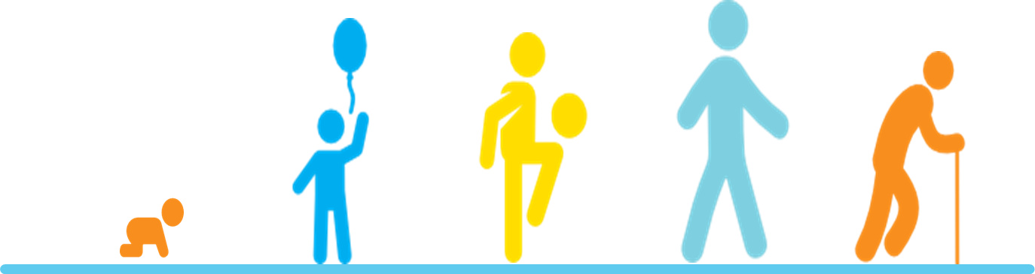
Health begins - and grows - where we live, work, learn and play
Health is mental, physical, emotional, social
The goal of health equity is for every American to have the means and ability to choose the right path toward health
.
Notes:
How to we give Americans the means and ability to choose the right path?

Slide 27
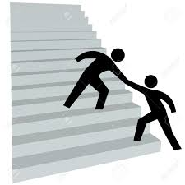
Equality and Equity
Health Equality
Everyone gets the same things in order to enjoy full, healthy lives.
  Only works if everyone starts from the same place and needs the same things
Health Equity
Give people tools based on what they need to enjoy full, healthy lives.
Notes:
Equality assumes everyone has equal and fair access to health if they are all given the same thing. This thinking relies heavily on personal responsibility. Certainly personal responsibility is an important factor, but that’s not really taking into consideration the root cause of some health behaviors. It’s not equal when someone’s home, their community environment and access to healthy practices, or their job make it so much harder to maintain health.
Health equity proposed that we match resources to need.

Slide 28
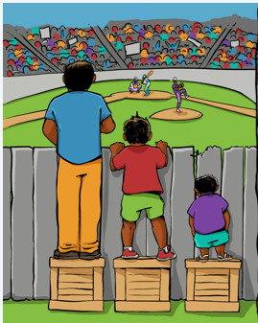
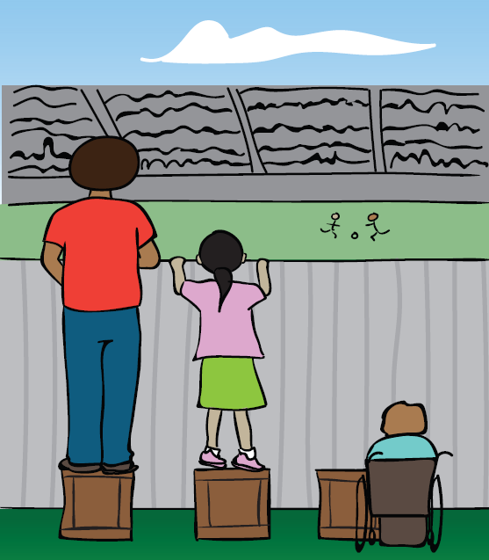
Health Equity
Everyone has the opportunity to attain their full health potential and no one is disadvantaged for achieving this potential because of their social position or other socially determined circumstance.
Notes:
Health disparity is different health outcomes among groups of people. In public health we are interested in the root cause of health disparities related to the social/economic environment. DOH is adopting the CDC definition of health equity.

Slide 29
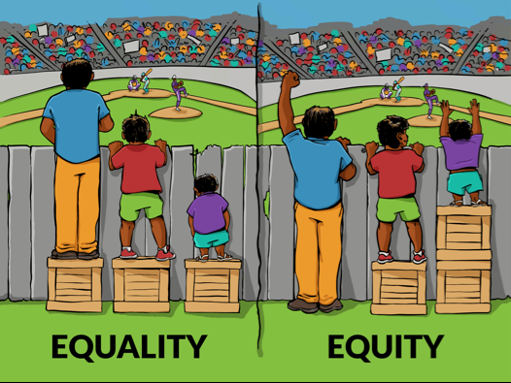
Notes:
Health inequality would result of the children on the right had smaller boxes, this is equality but it’s not equitable

Slide 30

Notes:
So, what’s next to make America healthy? Our track record isn’t great. To really make a difference we may have to get off this highway and take a new route.

Slide 31
America Leads The World
Most expensive healthcare system in the world
Not in the top 25 in life expectancy (behind Bosnia and Jordan)
30 trillion, 17.5% of the national budget (2014)
Only 3% spent on Prevention
$9,515
75.4
Life Expectancy at Birth
78.8
Healthcare Cost per Capita
350% Increase
$2,843

Slide 32
American leads the world
Child poverty among affluent countries
Ranked 34 out of 35 countries
Behind all of Europe, Australia, Canada, New Zealand and Japan
Poverty (Under 18 years)
Notes:
We passed the 50th anniversary of Lyndon Johnson’s war on poverty. It’s seems to be working just as well as the war on drugs.
We’ve clearly invested a great deal in trying to achieve optimal healthcare for Americans, but it’s failing for a large percentage of families struggling to get by
Chart data from Census.gov
https://www.census.gov/data/tables/time-series/demo/income-poverty/historical-poverty-people.html

Slide 33

Change the Way We Think About Health
Notes:
How do we translate “access” for all into health for all? Change the way we think about health. First, a story..

Slide 34
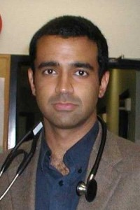
Dr. Rishi Manchanda, MD, MPH
“Living and working conditions account for 60% of preventable death. “
Veronica’s story
Notes:
Dr. Manchanda, MD, MPH (Tufts) in an internist, pediatrician, HIV specialist and member of the National Health Service Corps.
He works as a primary care physician in south central LA. This story came from his TED Talk.
Veronica’s story:
17 of the 26 patients he saw for the day. Complaint of chronic and severe headaches going on for years, but worse lately. Multiple trips to Urgent Care and ER, multiple tests run with no conclusive dx. Prescribed pain medications. When she came to Dr. Manchanda’s clinic in SC LA she was greeted and interviewed by a medical assistant, someone who had a GED, but lived in the community. After taking her vital signs the assistant asked, “Veronica, tell me about where you live. Specifically, about your housing conditions- do you have mold, water leaks? Are there roaches in your home?” Turns out Veronica had all three.
Dr. Manchanda reviewed the chart and told Veronica, “I think I know what's going on. I think you have chronic allergies with migraine headaches and sinus congestion, and I think all of those are related to where you live. Now, lets talk about treatment. We’re going to order some medication for your symptoms, but I also want to refer you to a specialist if that’s okay.”
The specialist is a community health worker who, if it’s okay with you, can come to your home and try to understand what's going on with those water leaks and that mold, try to help you manage those conditions in your housing that I think are causing your symptoms, and if required, might refer you to another specialist called a public interest lawyer, because it might be that your landlord isn’t making the fixes he’s required to make.”
Versonica came back a few months later 90% better. She was spending more time a work, less on shuttling back and forth to doctor appointments and emergency rooms. Her health had improved remarkably. Her sons, one of whom had asthma, were no longer as sick as they used to be. She questioned why no one had asked those questions. She had 2 CAT scans, spinal tap, a dozen blood tests and not one person asked about my home.
The cure started with one question: “Veronica, tell me about where you live.”
“Having a nurturing childhood, eating healthy food, exercising in a safe neighborhood, and avoiding violence and drug abuse have far more to do with health than health care, and are strongly related to where you live.”
Now that’s a really different way of practicing medicine.

Slide 35
Change the Way We Think
Stop thinking of health as something people get in the doctor’s office. That’s sick care
Recognize that health comes from homes, schools, worksites, playgrounds and parks, in the air we breath and the water we drink.
Focus on the root causes of health and disease
Imagine a system where everyone can see a doctor, but we’ve made it less likely they will need to.
Notes:
Dr. Manchanda, and other experts in this field, recommend we expand the role of the medical community. It starts with changing the way we think.

Slide 36
Change the Way We Think of Health
Good health requires:
  Safe communities, freedom from violence
  High quality education, safe jobs with a fair wage
  Decent and safe housing
  Nutritious foods
  Opportunities to be active and engaged
  Reliable transportation
  Clean water and non-polluted air
                Healthy People 2020
Notes:
The fact that humans are social creatures and social connections really matter seems to be lost in our traditional health system. Think how completely we separate mental health and physical health – or dental health for that matter. We have not focused on the individual as a whole – physical – mental – emotional being

Slide 37

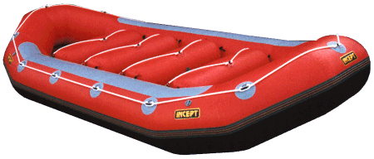

Change the Way We Think of Health
Notes:
Change the way we think about where the interventions should occur.
Three friends meet at a river. They hear cries and find several children in need of rescue from the river. The first friend says “I’m going to rescue those about to drown, the ones at most risk.” The second friend says, “I’m going to build a raft and go further upstream to see if I can get the children out before they get near the fall.” They work hard and have some success, but more and more children are in need of help, and some slip through. They look for their third friend, but she's nowhere to be found. Finally they see her swimming upstream and yell, “Where are you going? There are children to be saved!” She replies, “I’m going to find out who or what is throwing these children in the water.”
Become an Upstreamist – Dr. Rishi Manchanda
www.ted.com/talks/rishi_manchanda_what_makes_us_get_sick_look_upstream

Slide 38

Change the Way We Think of Health
Root Cause
The Upstreamist finds the root cause
Vaccines, education, preparedness, community assessment
Primary care medicine, social support programs
Emergency rooms, food banks, homeless shelters
Public Health
Notes:
If we look at the CDC and HP2020 definitions of what is required for good health, then it’s clear we must go upstream

Slide 39
Change the Way We Think About Health
Root Cause
Intermediate Outcome
Goal
  Freedom from
  discrimination
  Job opportunities
  Food access & security
  Decent house
  Community safety
  Access to medical care
  Social support and engagement
  Family support
Health
Health promoting behaviors
Notes:
If low income and education, poor housing and built environment, limited access to quality care and poor family and social support can create poor health, why don’t we think of the opposite as creating good health? If we address the root cause, healthy behaviors is an intermediate outcome.
It’s all connected!
Promoting Health Equity: A Resource to Help Communities Address Social Determinants of Health.

Slide 40

What Can You Do?
Think about barriers:
  Appointment times, meeting time and place
  Health messages
  Health literacy
  Access to services
  Culturally sensitive counseling
Become part of the conversation
  Talk with peers and community partners
  Advocate for public health participation in talks about community planning, transportation, housing
Notes:
This focus on root cause can seem overwhelming. Why is this my job? I’m a nurse, doctor, dietitian, environmental specialist, clerk, biologist. Health equity has to be everyone’s job. Public health needs to be part of the conversation and part of this solution. To do that we have to recognize the problem and work with partners on solutions.
We already practice health equity:
WIC – walk-in clinics, farmer’s markets onsite
Immunization pods and walk-in services
Healthy Start – going into homes and referring for multiple services
HIV and STDs– bringing testing and resources to the community
UF Pediatrics program coming to FDOH-Escambia will create a one-stop health center for families
PHP has special plans for vulnerable populations
I’m sure there are other examples and I’d love to hear about them

Slide 41
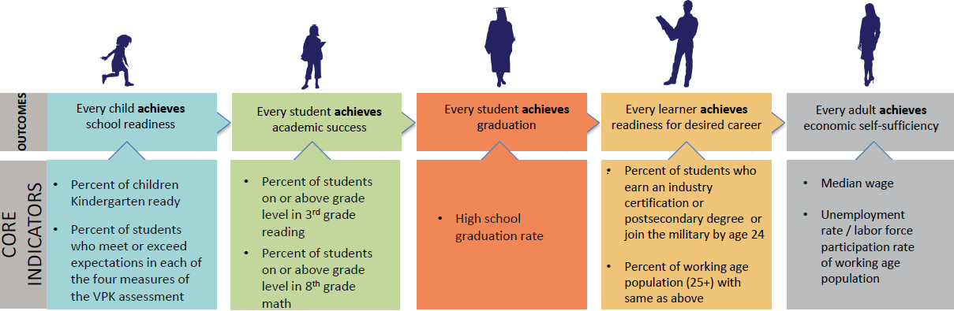
What Can Our Community Do?
Achieve Escambia
30 Million Words Project
Weiss Community School
Food Insecurity Team
Community Health Assessment
Notes:
Achieve Escambia – bringing together early childhood advocates, school district, major employers (Gulf Power, Penn Air, Studer,) Police Dept, Children and Families, Public Health and UWF Haas Center to look at interventions that will improve successes from cradle to career.
30 Million Words - The program gets its name from a study published in the 1990s that found children in low-income homes heard 30 million fewer words by age 3 than children in high income homes. They also heard a smaller variety of words and fewer words of encouragement. And those differences in language exposure had an apparent effect: Children from word-poor homes ended up with smaller vocabularies and worse school performance. Studer Institiute. Sacred Heart Hospital will be the first location where this research will be done in Pensacola, with Baptist and West Florida hospitals joining the research project later this year.
Weiss Community School- bringing multiple services to one, accessible location. The community school model (2nd in the state) prioritizes health, growth and learning, community engagement and safety. ECC is operating clinical and dental services, behavioral health therapists, bringing in others to help navigage insurance eligibility, budgeting, shopping.
Food Insecurity Work Group
Community Health Assessment

Slide 42
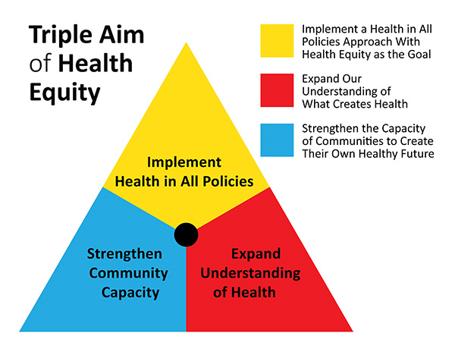
Notes:
This change won’t happen quickly, so don’t panic. Right now we, along with many other disciplines and organizations, are working on expanding our understanding of health. Encourage other organizations to begin learning about this so we can act together on the root cause of poor health.
ASTHO www.astho.org/Health-Equity/2016-Challenge/Ehlinger-Commentary-Article/

Slide 43
Thank you!
Questions?

Slide 44

Community Engagement

