Slide 1
A Spatial Analysis of Low-Income Communities in Pensacola, FL to Determine Areas of Need in Relation to the Availability of Fresh Food and Transportation
Department of Health
Richard Stone
Public Health Intern with the Escambia County Health Department
University of West Florida
Date: 08/06/2020
Project Year: 2019/2020
Kimberly Pace / Internship Preceptor

Slide 2
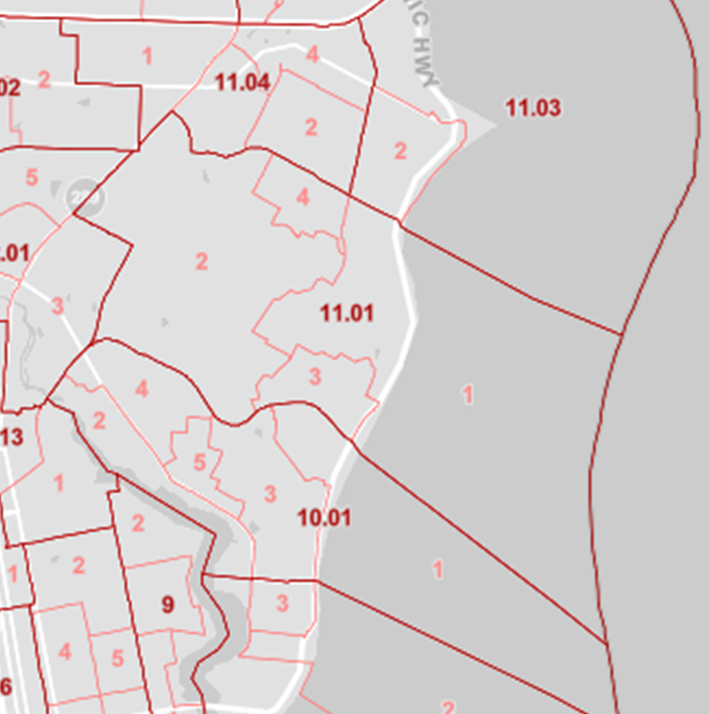
Defining Census Data Geographies
Census Tract
Statistical subdivisions of a county
Population size between 1,200 and 8,000 people
Optimum size is 4,000 people
11.01 is a census tract
Census Block Group
Statistical subdivisions of a census tract
Population size between 600 and 3,000 people
4 divisions of 11.01 are census block group
Notes:
A unique feature of census data is you can apply the data to different geography types. While many may be familiar with county and zip code geographies there are other smaller geographies that may be unfamiliar. The two used in this study are census tracts and census block groups. Census tracts are statistical subdivisions of a county ranging between 1200 and 8000 people. In the picture to the left 11.01 is an example of a census tract on the east side of Pensacola. Census block groups are a statistical subdivision of a census tract ranging between 600 and 3000 people. In the picture to the left, 11.01 is divided into 4 geographies.

Slide 3
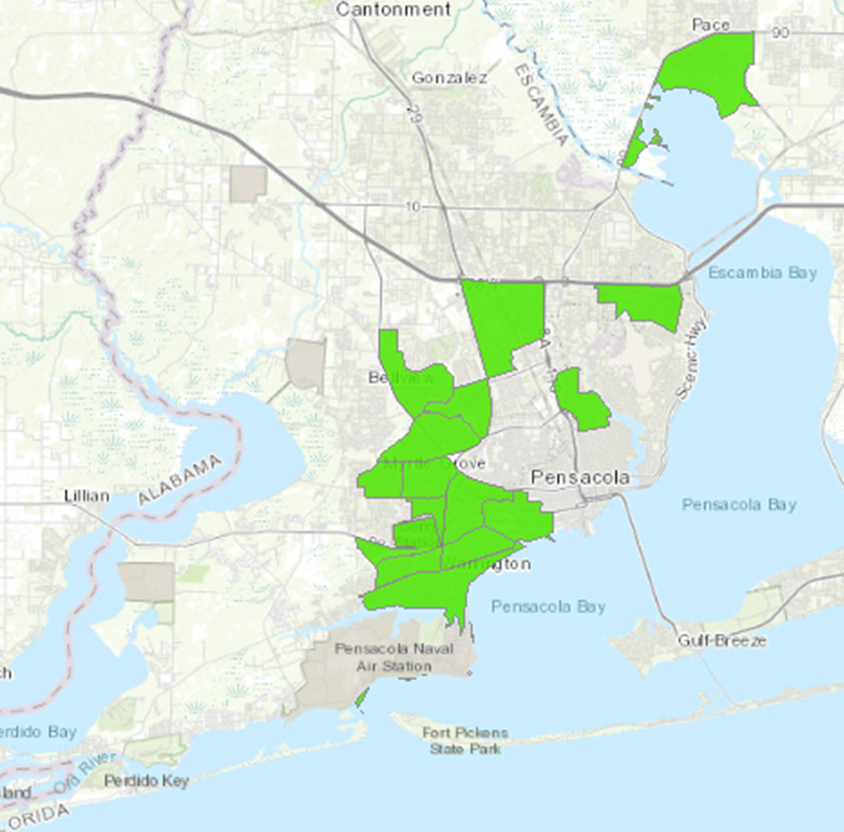
USDA’s Food Access Research Atlas
According to the Food Research Atlas there are low income communities in the Pensacola area that may have trouble getting to stores that sell fresh food items
The Atlas provides a spatial overview of food access for low income communities
Census data is used to determine income status
Urban residents that are more than 1 mile away from the nearest supermarket are considered to have low food access
The light green areas are census tracts that were determined to have low food access
Notes:
The USDA’s food research atlas is a tool for community planning and research that provides a spatial overview of food access for low income communities. Low income criteria for the atlas are census tracts with a poverty rate of 20% or higher or a census tract with a median family income of less than 80% for the metro area. In urban areas low food access is determined by a census tract being more than a mile away from the nearest supermarket and in rural areas it is more than 10 miles. The map to the left shows atlas data for Pensacola, FL. The light green areas are census tracts that were determined to have low food access.

Slide 4
Why is Food Access Important?
Americans are not consuming the recommended servings of fresh fruits and vegetables, which could impact their health
Some possible reasons may be price, a lack of time, and not having stores nearby that sell fresh fruits and vegetables
If an individual and/or family has trouble getting to a grocery store they may choose to get food items from convenience stores
Most of the items found in convenience stores stores are not healthy (sodas, candy, pastries, and chips) and are contributing to the obesity problem in America

Slide 5
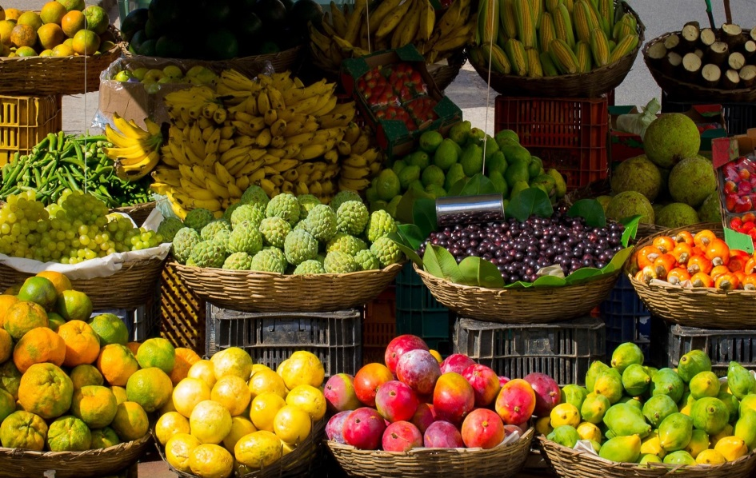
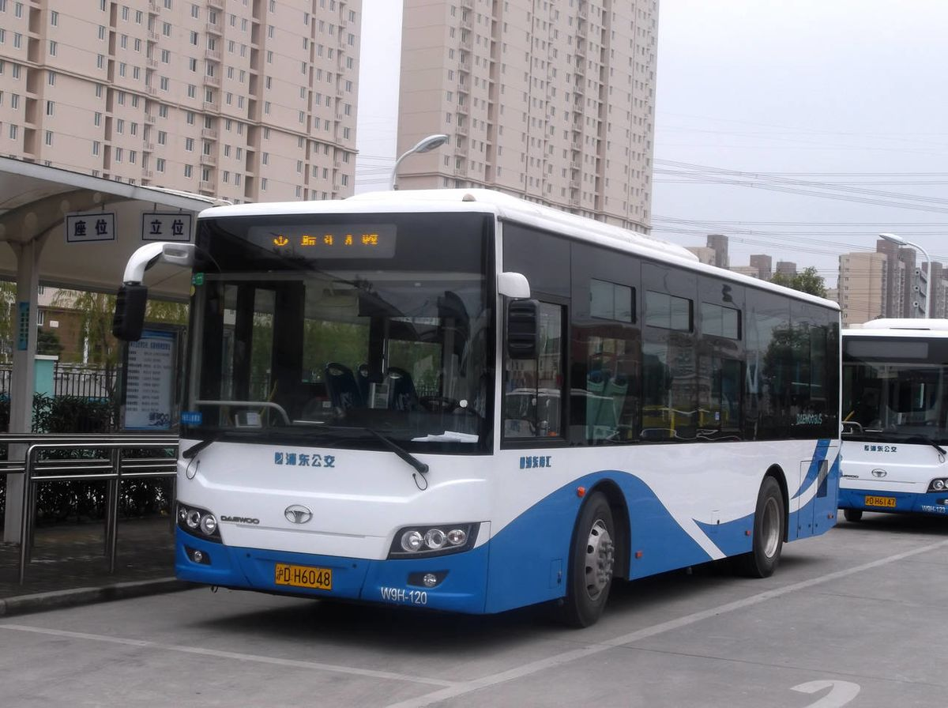
Research Questions
Do outside factors such as bus routes and smaller local grocery stores impact the status of those census tracts with limited access to food retailers?
What are the health implications associated with having limited access to food retailers?
Notes:
While the USDA’s food research atlas indicated that there are areas in Pensacola of low food access, it was determined that there needed to be a more comprehensive study of Pensacola’s food landscape. It was important to understand the impact of the city’s public transportation system and smaller local grocery stores on census tracts with limited access to food retailers. Also are there health implications associated with having limited access to fresh food retailers?

Slide 6
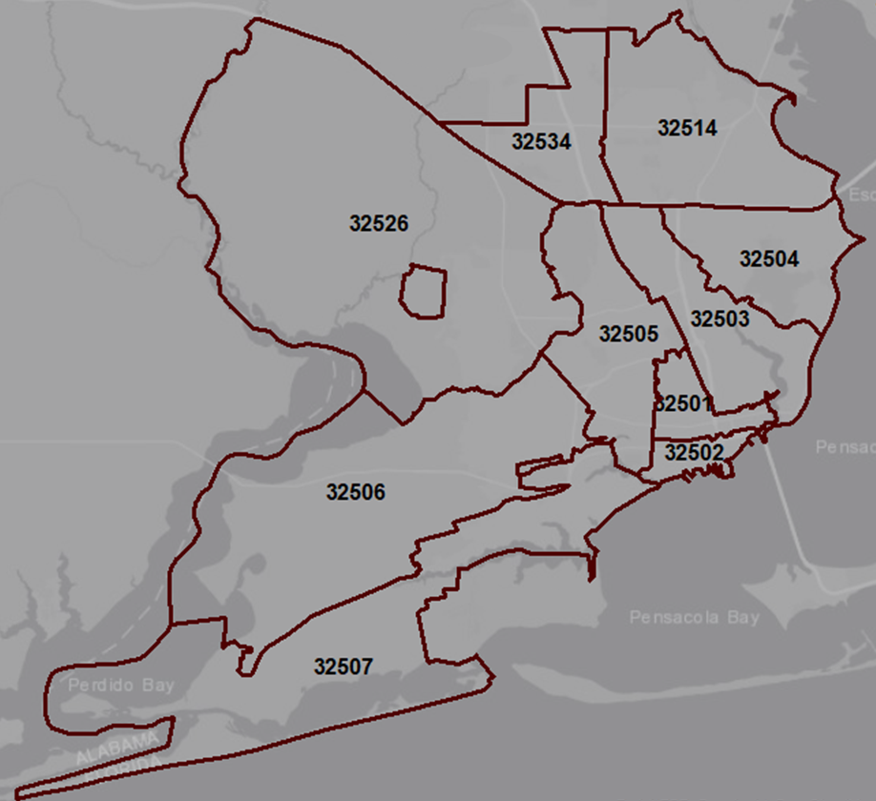
Study Area
10 zip codes of Pensacola, FL
Military bases were excluded
Comprised of 63 census tracts
Population of 275,402
Median Age of 38
21% of population under 18 years in age
16% of population 65 years or older
Notes:
The study area consisted of the 10 zip codes of Pensacola, FL. Military bases were excluded due to a lack of census data. The 10 zip codes encompassed 63 census tracts that had a population of 275,402 residents with a median age of 38.

Slide 7
Identifying Food Retailers
Data obtained from the Florida Department of Agriculture and Consumer Sciences inspection reports
This study classified stores in three different ways
Store type
Grocery Store (Publix, Winn-Dixie, Walmart)
Market (Bailey Produce, The Butcher Shoppe)
Minor Food Outlets (Dollar General, Dollar Tree)
Convenience Stores (Circle K Mart, Tom Thumb)
Bakeries/Coffee Shops/Sweet Shops (Drowsey Poet Coffee Shop, Flowers Foods)
Fresh food retailer – offer 6 or more fresh or flash frozen fruits or vegetables
Participation in food assistance programs
Supplemental Nutrition Assistance Program (SNAP)
Special Supplemental Nutrition Program for Women, Infants, and Children (WIC)
Notes:
Data related to food retailers was obtained from inspection reports provided by the Florida Department of Agriculture and Consumer Sciences. These reports provided the name of the retailer, address, and store type. Fresh food retailer designation was determined if they offered 6 or more fresh or flash frozen fruits and vegetables. Each retailer was also identified by their participation in the Supplemental Nutrition Assistance Program (SNAP) and Special Supplemental Nutrition Program for Women, Infants, and Children (WIC). SNAP participation was determined using the USDA’s SNAP retailer locator. WIC retailer participation was provided by the Escambia County Health Department.

Slide 8
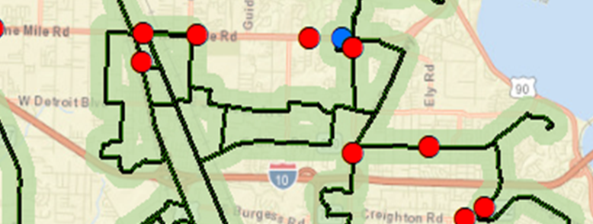
Identifying Public Transportation
Data obtained from Escambia County Area Transit (ECAT) website
Mapping software allowed researchers to identify all food retail establishments that were within a ¼ mile of an ECAT bus route
¼ mile was based off the ECAT 10-year transit development plan as an acceptable distance to travel for public transportation
Point does not fall within the light green outline which indicates ¼ mile distance from bus route
Notes:
Escambia County Area Transit (ECAT) routes were identified using data from the ECAT website. A ¼ mile buffer was used an all bus routes to determine coverage. The buffer was based off the ECAT 10-year transit development plan. A intersect analysis was used to determine which food retailers were within a ¼ mile of the bus route.

Slide 9
Determining Poverty Status
Used data from the 2017 American Community Survey conducted by the US Census Bureau
Poverty status
Census tract with a poverty rate of 20% or higher
Census tract with a median family income less than 80% for the metro area (Escambia County median income $36,382)
Borderline poverty status
Census tract poverty rate between 20% and 23%
Census tract with a median family income within $3,000 of the poverty cut off (median income between 36,383 and 39,382)
Notes:
Geographic information system (GIS) allows users to integrate different types of data to be analyzed spatially. A database was created using the ARC GIS software. Poverty status of census tracts in the database used data from the 2017 American Community Survey conducted by the US Census Bureau. Poverty status followed the guideline laid out by the USDA’s food research atlas. A borderline poverty status was added for census tracts that close to meeting the poverty guidelines.

Slide 10
Results: Food Retail Establishments
353 food retail establishments were identified in the study area
Most of the retail establishments were convenience stores (51.8%) and minor food outlets (22%)
12.2% of retailers were grocery stores
263 food retail establishments (74.5%) participated in the Supplemental Nutrition Assistance Program (SNAP)
Most retailers were convenience stores (49.1%) and minor food outlets (26.6%)
16.3% of retailers were grocery stores
32 food retail establishments (9%) participated in Special Supplemental Nutrition Program for Women, Infants, and Children (WIC)
90.6% of retailers were grocery stores
All establishments accepting WIC program benefits also accepted SNAP benefits
Notes:
There were 353 food retail establishments identified. Most were convenience stores and minor food outlets. Minor food outlets were retailers who sell some food in addition to other items like decorations or school supplies. Some examples are Dollar General, Dollar Tree, and Walgreens.
263 (74.5%) of food retail establishments participated in SNAP. Most of which were convenience stores and minor food outlets.
32 (9%) food retail establishments participated in the WIC program. Grocery stores made up a majority of the participants.

Slide 11
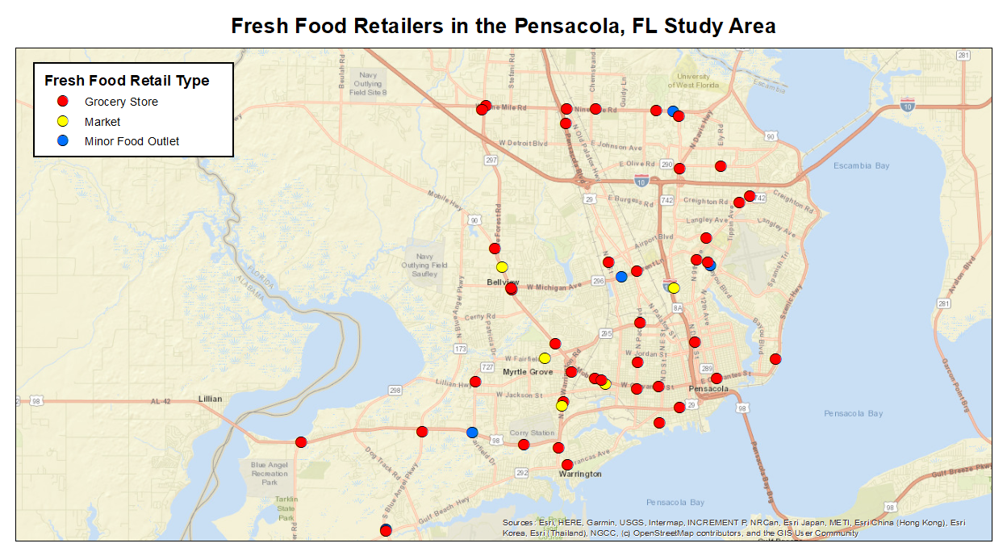
15.3% of food retail establishments met the requirements of being a fresh food retailer (6 or more fresh and/or flash frozen fruits and/or vegetables)
Notes:
Map of all identified fresh food retailers in the study area (6 or more fresh/flash frozen fruit and/or vegetable items). 15.3% of food retailers met the fresh food requirements

Slide 12
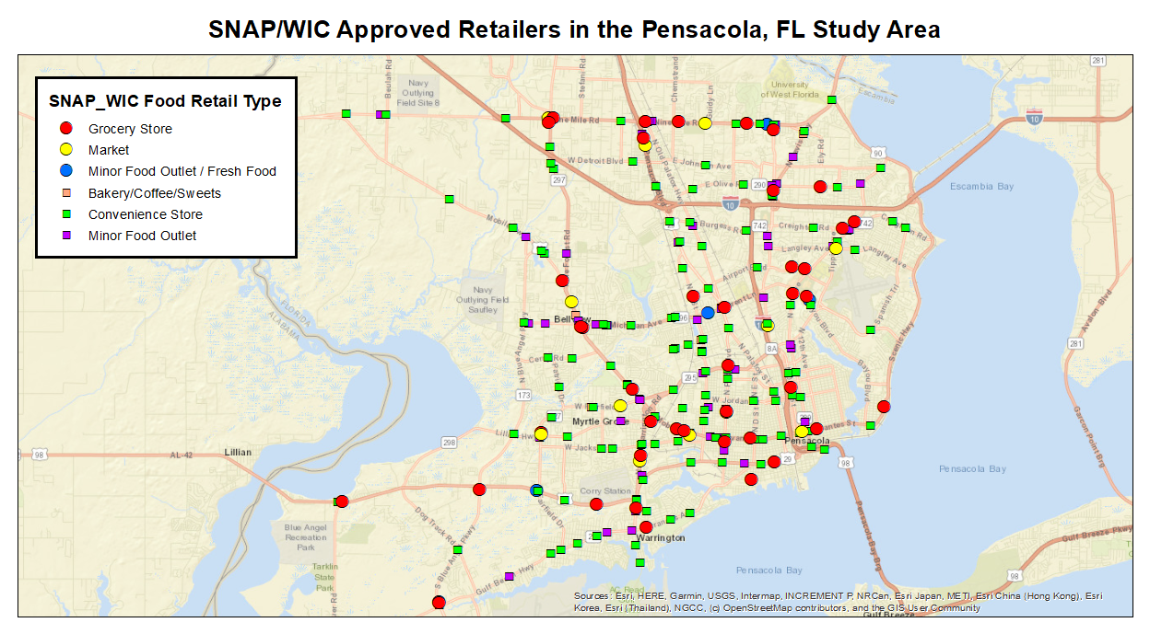
The circle marker indicates that the retailer met the fresh food requirements and the square marker are those that did not
All establishments accepting WIC program benefits also accepted SNAP benefits
Notes:
This maps shows the locations of all SNAP/WIC approved food retail establishments. The circle designation indicates that the retailer met the fresh food requirements. The square designation are those not meeting the fresh food requirements. All the establishments accepting WIC program benefits also accepted SNAP benefits.

Slide 13
Results: Public Transportation System
263 food retail establishments were SNAP/WIC approved retail establishments
Remember that all the establishments accepting WIC benefits also accepted SNAP benefits
Of those approved retailers 83.6% were within ¼ mile of an ECAT bus route
Most retailers were convenience stores (46.4%) and minor food outlets (28.6%)
16.3% of retailers were grocery stores
The next two slides are going to show the bus routes (dark green lines) and their ¼ mile buffer (light green shading surrounding the dark green lines). If the circle or square marker falls within the light green area then they are within ¼ mile of an ECAT bus route.

Slide 14
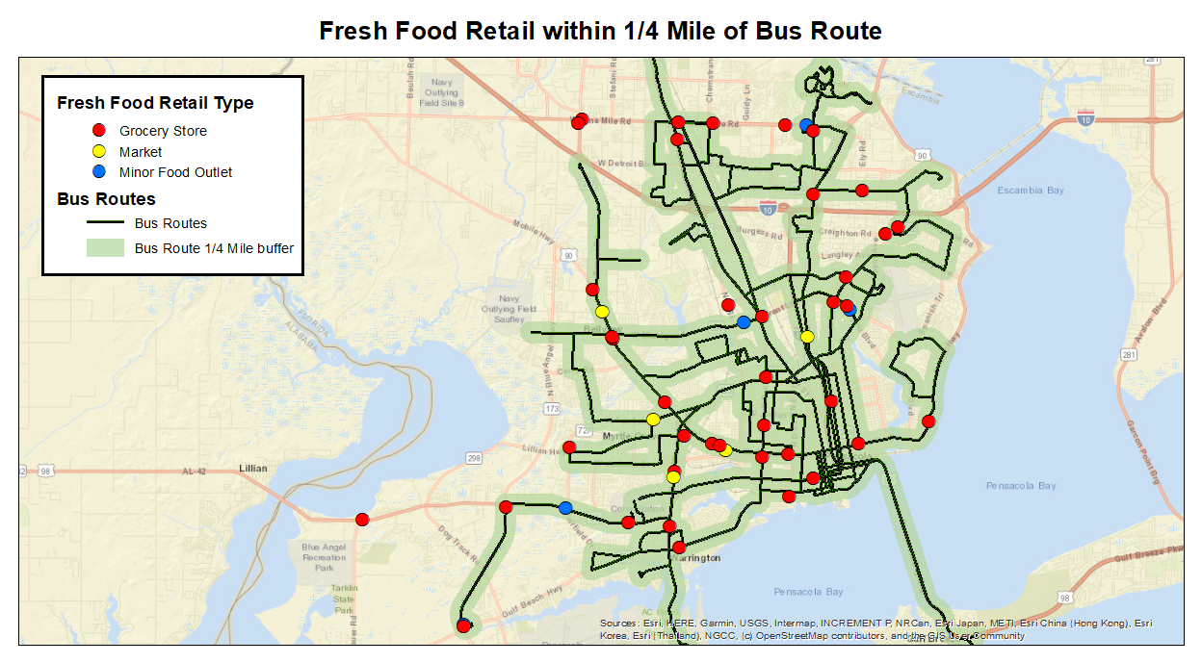
87% of fresh food retailers were within a ¼ mile of the public transportation system

Slide 15
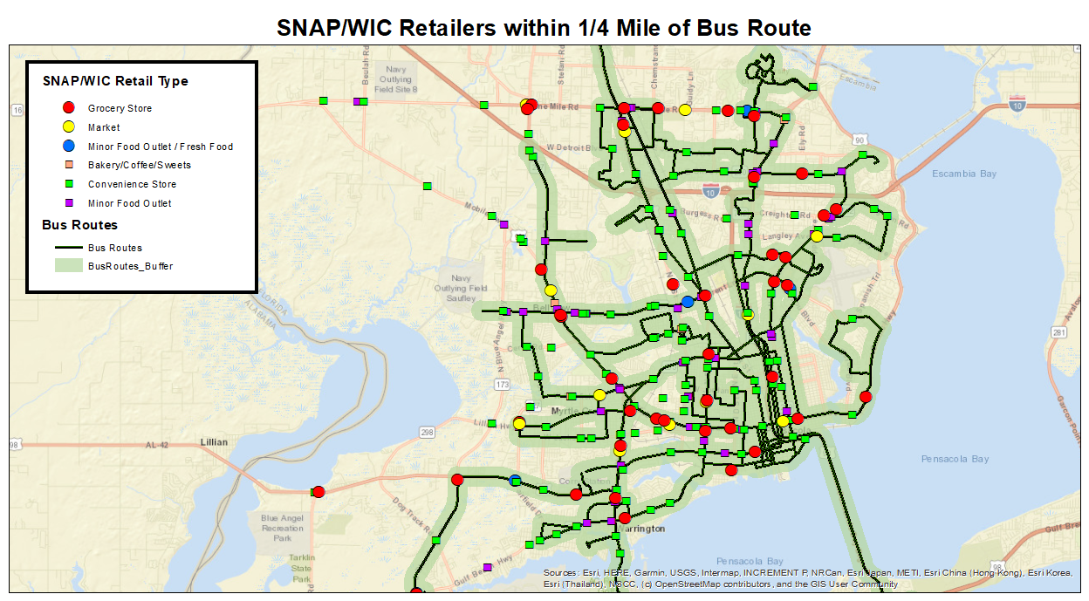
83.6% of SNAP and WIC retail establishments were within a ¼ mile of the public transportation system

Slide 16
Results: Census Tract Poverty Status
The study area was made up of 63 census tracts
34.9% of census tracts met the poverty requirements of a poverty rate of 20% or higher and/or a median family income less than 80% for the metro area
6.4% of census tracts met the borderline requirements of a poverty rate between 20% and 23% and /or a median family income within 3,000 of the poverty cut off
The next slides are going to show the locations of those meeting the poverty requirements (dark red shading) and those that are a borderline status (light blue shading). There will also be maps showing the food retailers locations in relation to the census tracts meeting the poverty or borderline status guidelines

Slide 17
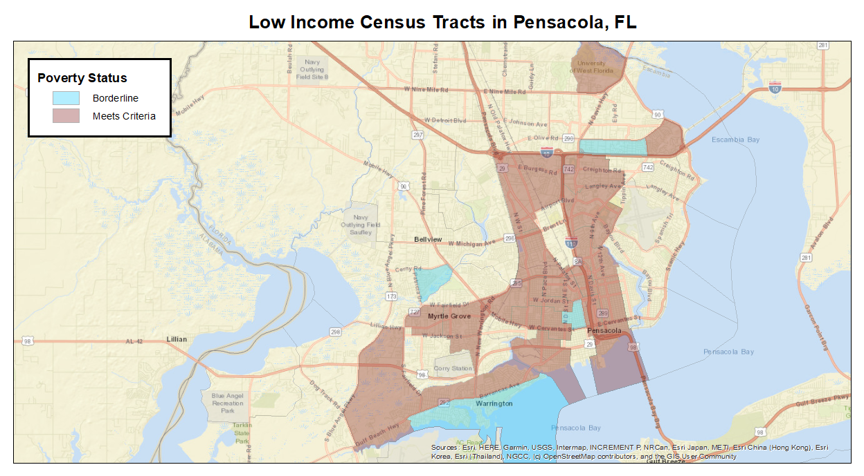

Slide 18
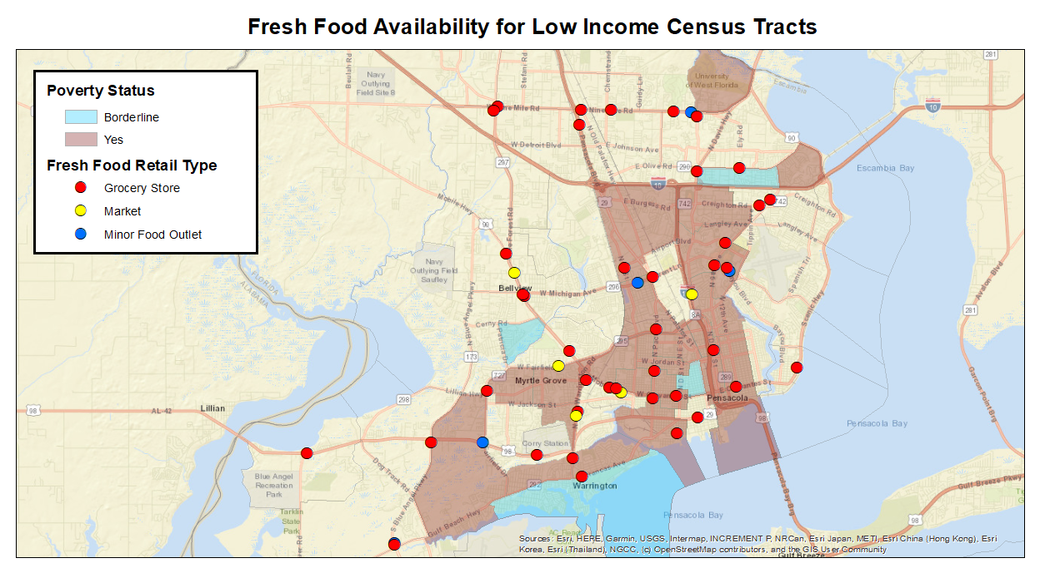
61.5% of census tracts who meet the poverty or borderline status guidelines have a fresh food retailer within the tract’s boundary

Slide 19
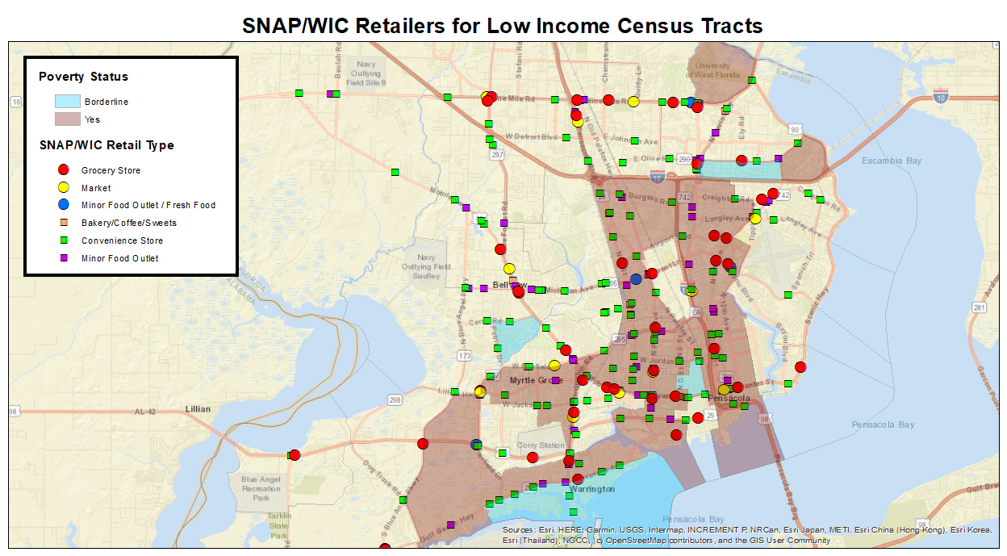
All census tracts meeting the poverty guidelines or having a borderline status have a food retailer(s) participating in the SNAP and/or WIC program within their census tract

Slide 20
Results: Census Tract Poverty Status
263 food retail establishments were SNAP/WIC approved retail establishments
Remember that all the establishments accepting WIC benefits also accepted SNAP benefits
Of those approved retailers 47.9% were within the border of a census tract meeting the poverty or borderline status guidelines
Most retailers most were convenience stores (48.4%) and minor food outlets (31.7%)
15.9% of retailers were grocery stores
The next slides is going to show the locations of those meeting the poverty or borderline status guidelines, fresh food retailers locations, and ECAT bus routes with their ¼ mile buffer zone. Remember that we are trying to determine low income areas that may have trouble getting fresh food items.

Slide 21
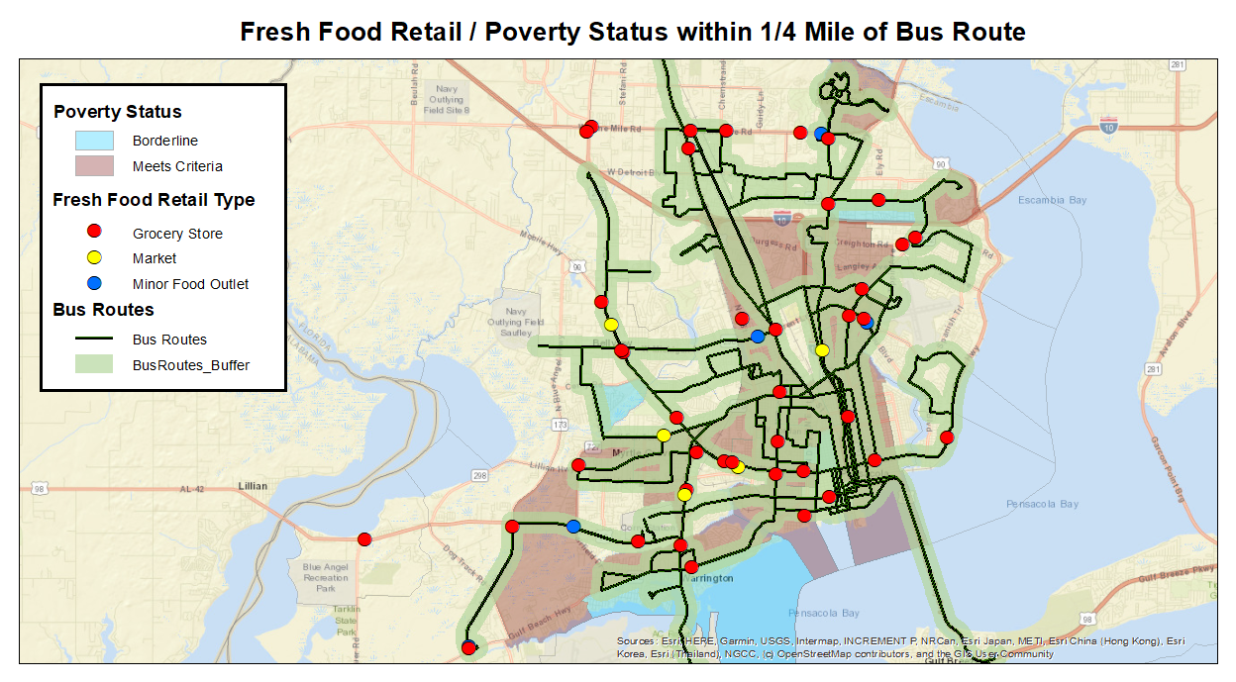

Slide 22
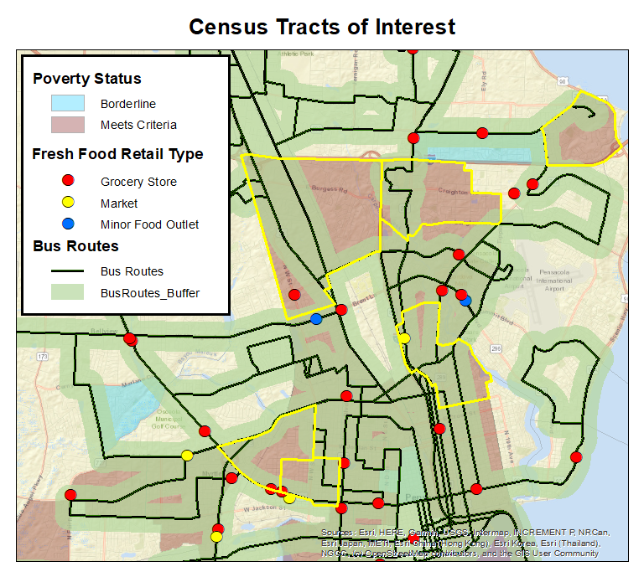
These highlighted census tracts were identified as potential areas of concern with regard to transportation to fresh food.
We wanted to understand the demographics of these tracts.
That information is broken down on the next few slides.
35.06
14.02
12.02
13
20
19

Slide 23
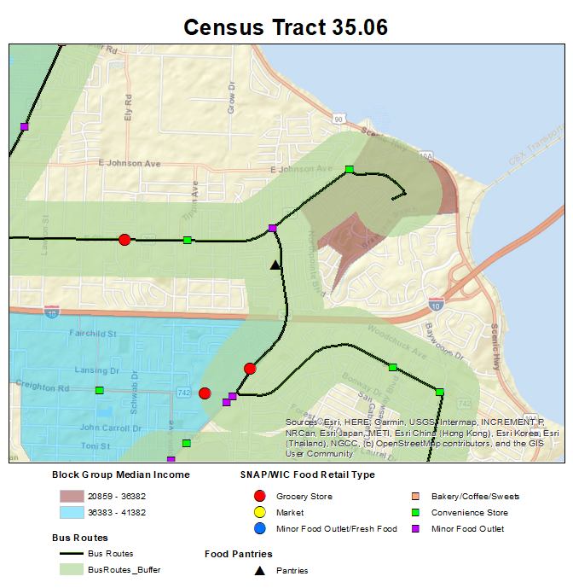
Census Tract Information
Age
Median Age – 32.2
% 65 and older – 12.8
Old Age Dependency Ratio – 22.5
Child Dependency Ratio – 53.8
Race
White Alone – 3142
Black or African American – 981
Other Race – 1106
Housing
% Owner Occupied – 56.5
% Renter Occupied – 43.5
% Housing Unit with No Vehicle – 8.2
Income
Median Income – 44,911
Percent Poverty – 22.9
For these next slides we wanted to make note of the % with no vehicle access, Median income, and % poverty for comparing the different census tracts that were identified.
Notes:
Census tract 35.06 is located within the red circle. The block group which may have been a driving force for the census tract’s poverty status has access to public transportation. The census tracts demographic information can be found on the left along with information related to vehicle access, median income and percent poverty

Slide 24
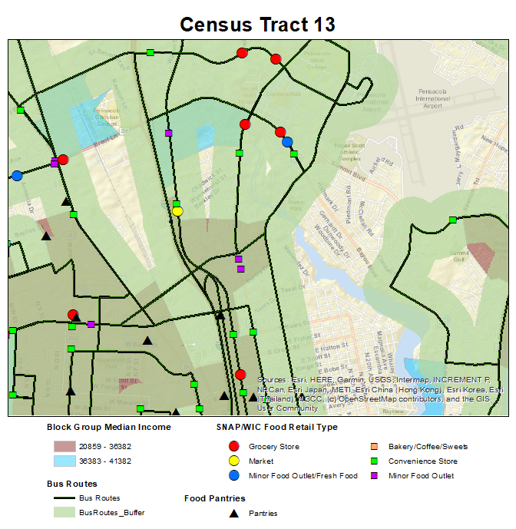
Census Tract Information
Age
Median Age – 28.5
% 65 and older – 14.6
Old Age Dependency Ratio – 27.8
Child Dependency Ratio – 62.2
Race
White Alone – 1379
Black or African American – 3263
Other Race – 349
Housing
% Owner Occupied – 56.9
% Renter Occupied – 43.1
% Housing Unit with No Vehicle – 13.4
Income
Median Income – 34,922
Percent Poverty – 36.3
Census tract 13 is of special interest because it: is identified by USDA as a Food Desert / has ‘adequate’ coverage with bus routes / has higher rates of death due to disease
Notes:
While census tract 13 has plenty of access to public transportation and a fresh food retailer, it was of special interest because it was identified by the USDA’s food atlas and has higher rates of death due to disease.

Slide 25
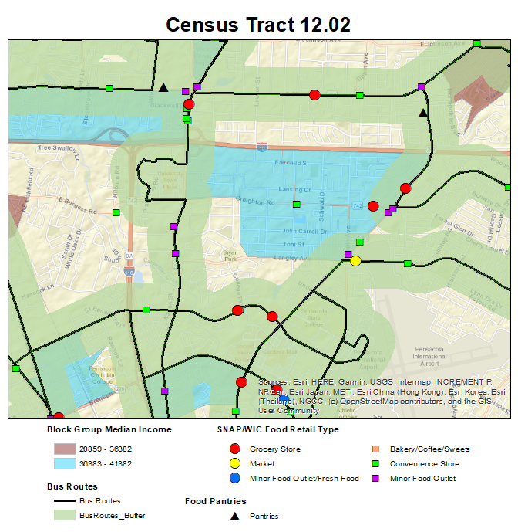
Census Tract Information
Age
Median Age – 27.9
% 65 and older – 10.8
Old Age Dependency Ratio – 18
Child Dependency Ratio – 49.3
Race
White Alone – 3208
Black or African American – 924
Other Race – 693
Housing
% Owner Occupied – 39.4
% Renter Occupied – 60.6
% Housing Unit with No Vehicle – 5.6
Income
Median Income – 34,890
Percent Poverty – 23.5
Notes:
Census tract 12.02 has an area of light blue indicating the block group meets the borderline status and is a driving force for the census tracts poverty status. This light blue area is along Creighton Rd which does not have public transportation access and a convenience store in the middle of the block group.

Slide 26
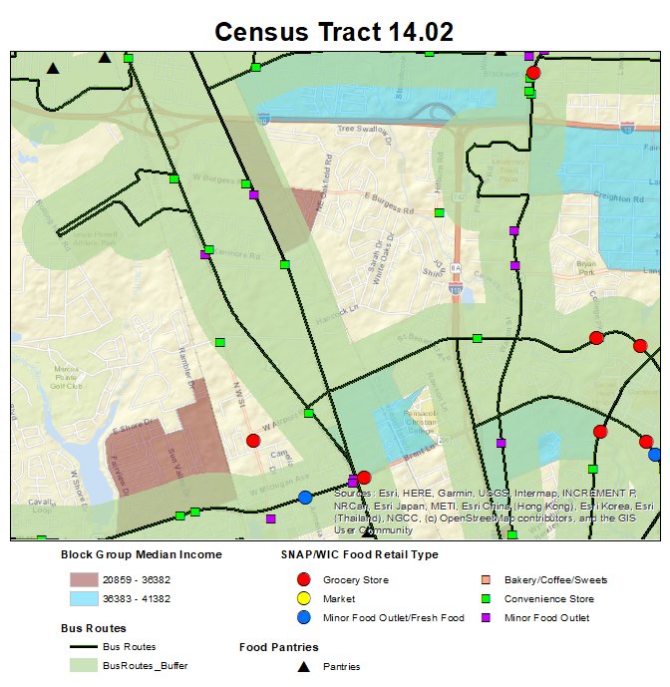
Census Tract Information
Age
Median Age – 34.2
% 65 and older – 15.8
Old Age Dependency Ratio – 25.9
Child Dependency Ratio – 37.5
Race
White Alone – 3925
Black or African American – 2771
Other Race – 896
Housing
% Owner Occupied – 54
% Renter Occupied – 46
% Housing Unit with No Vehicle – 11
Income
Median Income – 41,427
Percent Poverty – 22
Notes:
The block groups in census tract 14.02 that meet the poverty status and borderline status have access to public transportation but also have convenience stores and minor food outlets in a close proximity.

Slide 27
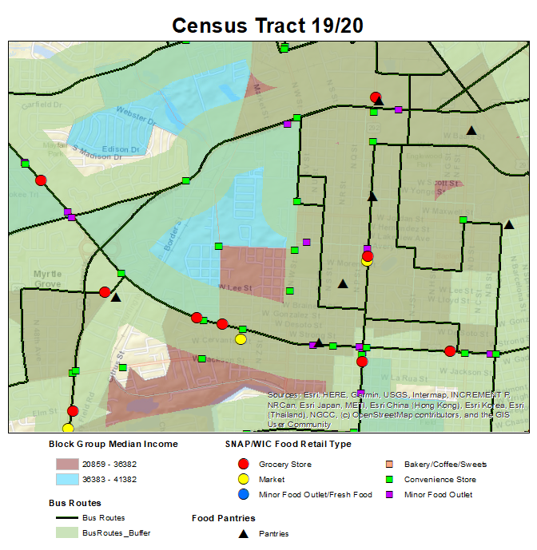
Census Tract Information
Age
Median Age – 36.5 / 44.7
% 65 and older – 14.4 / 25.2
Old Age Dependency Ratio – 22.5 / 45.1
Child Dependency Ratio – 33.4 / 34.2
Race
White Alone – 863 / 905
Black or African American – 965 / 861
Other Race – 175 / 178
Housing
% Owner Occupied – 51.5 / 34.9
% Renter Occupied – 48.5 / 65.1
% Housing Unit with No Vehicle – 12.4 / 10.2
Income
Median Income – 24,322 / 32,004
Percent Poverty – 35.5 / 18.2
Notes:
Lastly census tracts 19 and 20 have areas with limited coverage with a convenience store located in the center of the area with no coverage. Surrounding the area of no coverage is a mixture of grocery stores, convenience stores and minor food outlets.

Slide 28
Results: Disease Death Rates
Data from previous slides related to poverty status indicated that there are 63 census tracts in the study area.
58.7% of census tracts did not meet the poverty guidelines, 6.4% were borderline status, and 34.9% met the poverty guidelines.
The death rate is the number of people per 100,000 that die of a disease in a particular area (census tract) over a defined time period (2014-2018). The death rates are provided by the Department of Health’s FLHealthCHARTS. It is important to remember the above percentages when examining the death rates on the next slide. You may notice that there is not much difference in the rates of death between the 58.7% of census tracts who did not meet the poverty guidelines and the 34.9% of census tracts that did meet the poverty guidelines.

Slide 29
Disease death rates of non-poverty census tracts versus census tracts meeting poverty guidelines and borderline status
 |  | Disease Death Rate (deaths per 100,000)
 |  | Heart Disease | Hypertension | Diabetes | Nutritional Related Disease | Cardio Disease
Census Tract Poverty Status
 | Did Not Meet Poverty Requirements | 6827.79 | 430.00 | 1072.19 | 68.20 | 7413.69
 | Borderline Poverty | 883.50 | 62..39 | 130.20 | 4.09 | 858.89
 | Met Poverty Requirements | 5888.90 | 334.70 | 870.89 | 59.39 | 5018.20
Source: American Community Survey, FLHealthCHARTS
Notes:
Data from the previous slide related to census tract poverty status indicated that of the 63 census tracts in the study area, 58.7% did not meet the poverty guidelines, 6.4 were borderline status, and 34.9% met the poverty requirements. When examining the death rates of those census tracts there is not much difference in the rates of death especially when taking into account the tracts not meeting the poverty requirements makes of 58.7% of the census tracts.

Slide 30
Disease death rates of highlighted census tracts
 |  | Disease Death Rate (deaths per 100,000)
 |  | Heart Disease | Hypertension | Diabetes | Nutritional Related Disease | Cardio Disease
Highlighted Tracts
 | 12.02 | 217.00 | 14.50 | 43.04 | 0 | 135.00
 | 13 | 335.70 | 28.00 | 60.59 | 4.69 | 261.10
 | 14.02 | 225.89 | 20.50 | 26.39 | 0 | 208.30
 | 19 | 217.50 | 20.70 | 51.79 | 10.39 | 279.70
 | 20 | 250.89 | 27.89 | 83.59 | 0 | 315.89
 | 35.06 | 191.80 | 0 | 13.69 | 4.59 | 260.29
Highlighted rates in orange were above the average calculated death rate
Notes:
The death rates for the census tracts highlighted as potential areas of concern are found in this table. The average death rate for each disease type was calculated for all census tracts meeting the poverty guidelines. The death rates that are highlighted light blue were above the average calculated death rate.

Slide 31
Conclusion
This study did show that outside factors such as bus routes and smaller local grocery stores did have an impact on some low income census tracts with limited access to food retailers
Census tracts meeting the poverty requirements of the study did have higher death rates of disease especially those with limited access to food retailers
This study provides a starting point for discussions and collaborations with other health professionals and stakeholders in the community
It is important that the needs of the community are examined to determine the most beneficial next step
Results should be shared with ECAT in hopes to address areas of limited access

Slide 32
References
Escambia County Area Transit (ECAT). (2016). Connections 2026 Escambia County 10-year transit development plan. Retrieved from https://goecat.com/docs/default-source/default-document-library/connections-2026-tdp-final-report.pdf
Escambia County Area Transit (ECAT). (2019). Routes and maps. Retrieved from https://goecat.com/routes-maps
Florida Department of Agriculture and Consumer Services. (2019). Search food establishment inspection reports. Retrieved from https://fims.freshfromflorida.com/Search/SearchFoodEntity.aspx
Florida Department of Health. (2019). FLHealthCHARTS: A community health assessment resource tool set. Retrieved from http://www.flhealthcharts.com/charts/default.aspx
United States Census Bureau. (2019). American fact finder. Retrieved from https://factfinder.census.gov/faces/nav/jsf/pages/index.xhtml
United States Department of Agriculture (USDA). (2019b). Food research atlas. Retrieved from https://www.ers.usda.gov/data-products/food-access-research-atlas/go-to-the-atlas.aspx

